Slide 1

Asexual reproduction in plants
By Akhyar Osman

Slide 2
What is Asexual Reproduction?
It is the process In which a new organism forms from a single parent.
This results in offspring more like the parent plant.
This type of reproduction in plants can occur through various ways such as budding, fragmentation, vegetative propagation, and spore formation.
Asexual reproduction is also used by unicellular and multicellular organisms.

Slide 3
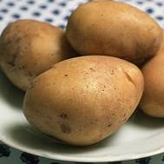
Potato reproduction
Potatoes reproduce asexually through vegetative propagation.
The growth and development of “stolons” is involved in it, which are horizontal stems that grow beneath the ground.

Slide 4
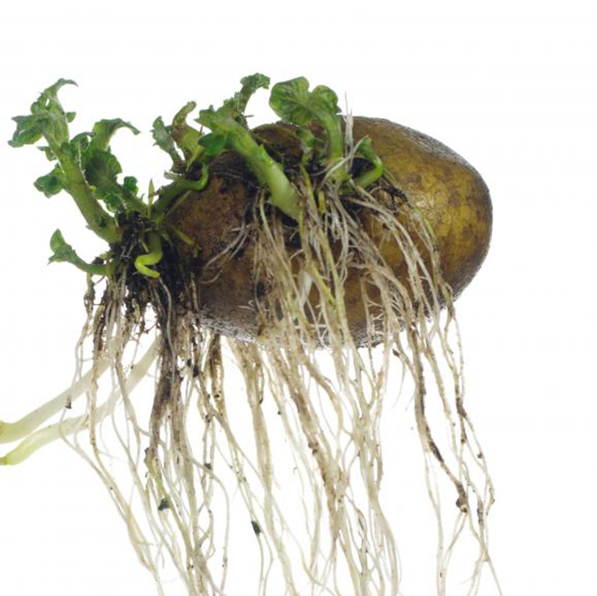
Stolons

Slide 5
How And Why?
After some research, researchers have found out that almost 90 percent of farmers use asexual reproduction methods while farming because of its many benefits such as every plant is identical to its parent, there is an increase in disease resistance. It is also more cost effective. Another reason is its simplicity, it doesn’t involve the complicated process of pollination and seed development. Also, there’s no need to pay the additional cost of seeds.

Slide 6
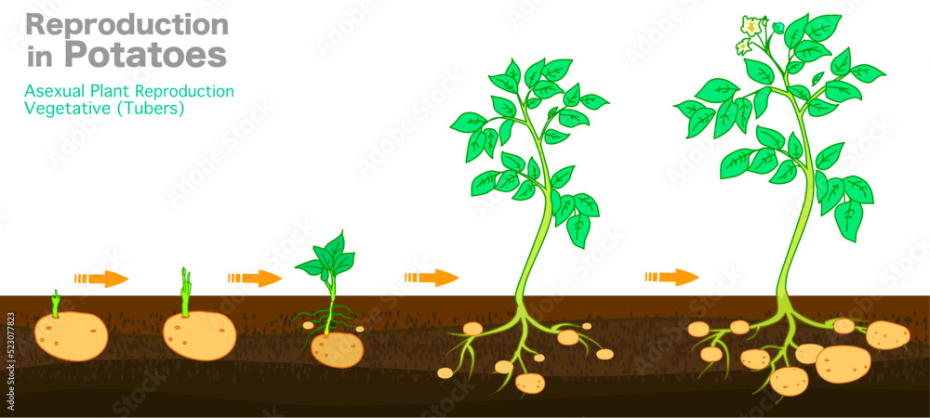
Asexual Reproduction cycle of potato

